Slide 1
Review of Top Ten and Records Requirements

Slide 2
Meet Results
Process for entering results of CT meets
Make sure meet is included USMS database of meets
Get results from the meet in HY3 or CL2 format
Audit swimmers for USMS eligibility
Review results and upload to USMS
Check to see if there is documented pool length certification
Including splits:
Use Split Notification Form – The swimmer must notify the Meet Referee of the intent to record an initial split time prior to the conclusion of the meet. The request for relay leadoff split times and initial backstroke distance times in individual backstroke events must be made prior to the swim.
https://www.usms.org/admin/lmschb/gto_rectab_split_request.pdf

Slide 3
Top Ten
Submissions 3 times per year: SCY, LCM, SCM
Types of meets included
USMS Sanctioned
USMS Recognized
USA Sanctioned
Other Recognized Meets
Responsible only for meets held in CT
Process
Make sure all CT meets are present in the USMS database
Check to see if there are any USA meets to include and enter those swimmers and results
Create the Top Ten Report, review and upload to USMS
Make sure there is a pool length certification for each meet (USA certifications do not count)

Slide 4
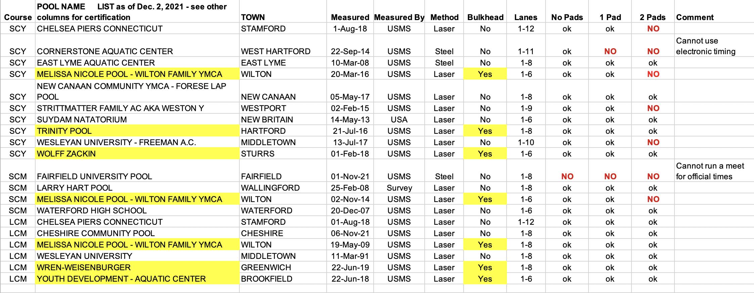
USMS List of Measured Pools in CT
https://www.usms.org/volunteer-central/guide-to-local-operations/lmsc-operations/top-ten-recorders

Slide 5
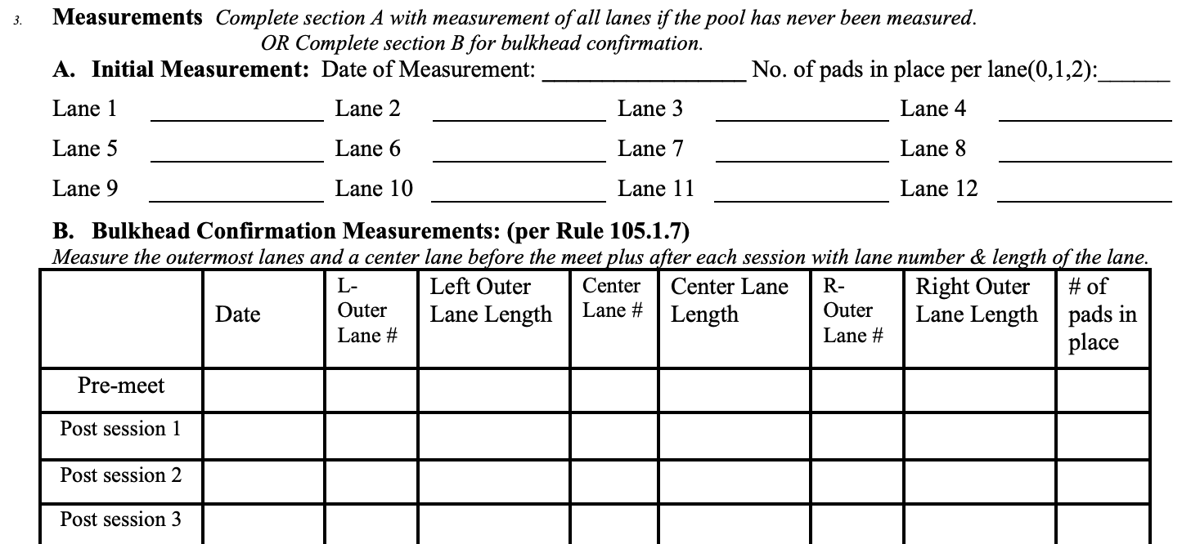
Pool Length Certification Form
https://www.usms.org/volunteer-central/guide-to-local-operations/lmsc-operations/top-ten-recorders

Slide 6
Application for Records
World records due within 60 days (can only be done in USMS meet, not USA sanctioned)
National records due within 90 days of end of season
Application (signed by meet referee)
Timing system; number of pads, buttons or watches (watches not accepted for world records)
Confirmation of swimmer’s age (birth certificate or passport)
If bulkhead, Pool Length Confirmation Form at end of session record was done
Results:
Heat sheet showing swimmer, event number, heat and lane
Printout of timing system showing event, heat, lane and splits (meet results are not a substitute)
https://usms-cdn.azureedge.net/-/media/usms/pdfs/guide%20to%20operations%20-%20gto/top%2010%20and%20rec%20and%20tab/gto_rectab_record_application.pdf?rev=973142718c58430b905c7b396ad404e5&hash=CB01C55CDC5EC6B0C002E2EDA76AC293

Slide 7
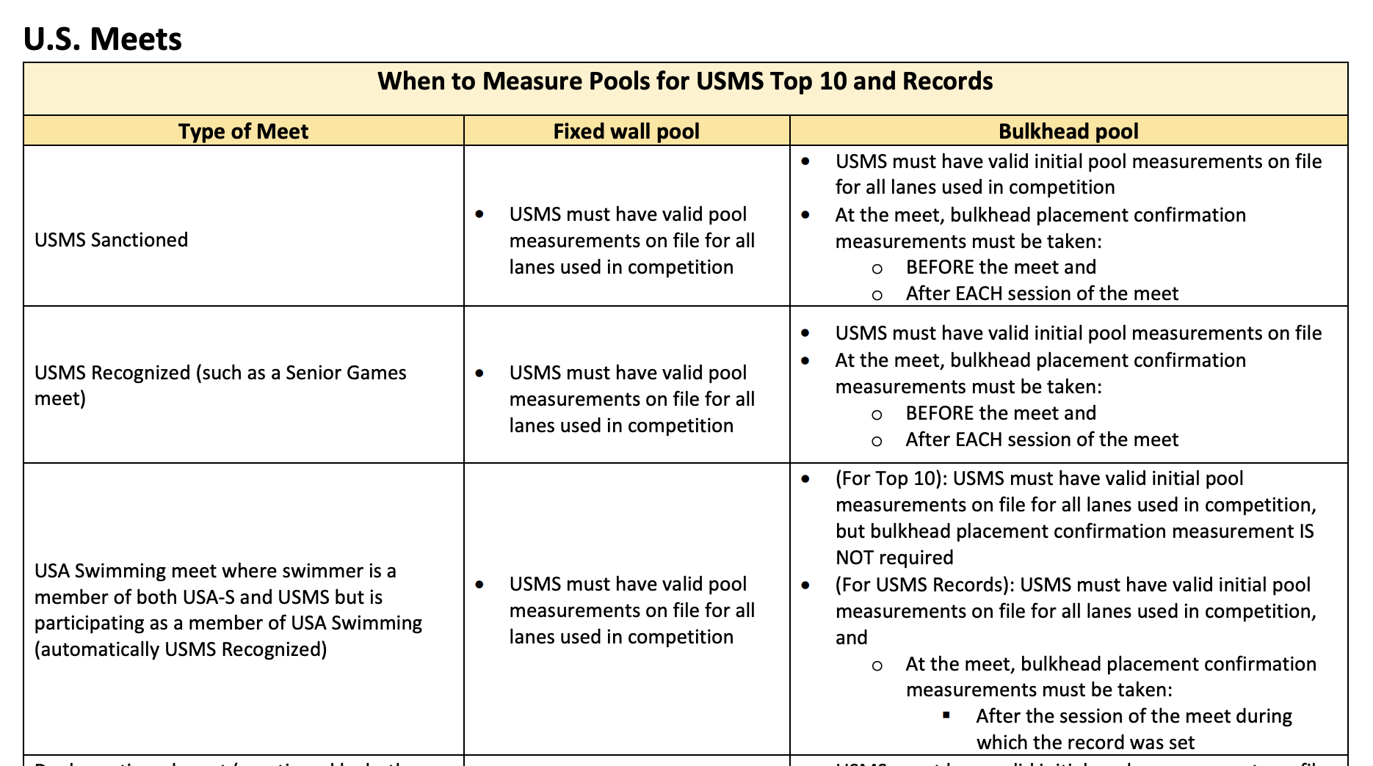

Slide 8
